Slide 1
NAPS Meeting
CPDO Briefing
Dane Coleman – VP Regional Processing Operations - Eastern
September 29, 2023

Slide 2

DELIVERING FOR AMERICA
Our vision and ten-year plan to achieve service excellence and financial sustainability
Notes:
Have you heard about our Delivering for America Plan? It’s a 10-year strategic plan to achieve service excellence and financial sustainability.
Today’s presentation will cover our recent efforts towards realizing key strategies of that Plan. Those include:
Service improvements and stabilization
Decreasing our financial losses
And Other Noteworthy accomplishments
We will also review the next set of key strategies that we plan to implement. Those include:
Transforming Our Network and Delivery Units
Improving Our Sales & Marketing Approach
Empowering and Engaging Our Workforce
Investing in Our Future by Infusing Capital into Our Organization
We will also provide an update on our Holiday Peak Season Preparations, which are in full swing.

Slide 3


Our
Greatest
Asset
Notes:
Keynote begins with greeting the audience –
Welcome and thank the attendees for investing in themselves and dedicating time to attend off-the-clock to continue to explore opportunities for future roles and learn how to own the career path that leads to a dream job.
Thanking those who contributed to making the conference an engaging and interactive experience.
Local planning committee – this group has been working for months to plan every conference detail.
Greetings to the presenters — those subject matter experts who are presenting the decks, and are passionate about helping other grow and develop.
Local executive and managerial leadership — here to support the conference, to network and connect with conference attendees, and to look out for talent so that they can build their benches and expand their diverse candidate pools.
All the representatives that are staffing informational booths – internal and external partners who are interested in telling you more about what they do and where you may fit in.

Slide 4






Our People Are Our Greatest Asset
Our success depends on investing in the future of our workforce. We strive to be an “employer of choice” that hires, develops, and retains the most capable and diverse set of employees. Our plan focuses heavily on improving our collaboration and engagement within the workplace and strengthening the employee experience through the following measures:
Conversions: from pre-career employees to career status
Frontline Supervisor Empowerment: new training program, better tools, and more resources
Workforce Development: defined career paths, enhanced and expanded training, career conferences, and strengthened succession planning
Engaged, Collaborative Leaders: installing a culture of organizational focus, transparency, and accountability
Building a Stable and Empowered Workforce
Executive Diversity Council: building a diverse pipeline of talented candidates, focused on leadership positions
Notes:
Our greatest asset is our people. Our success depends upon you, so investing in the future of our workforce is vital. We aim to be an “employer of choice.” We aim to hire, develop, and retain the most capable and diverse set of employees.
The DFA Plan focuses heavily on improving our collaboration and engagement within the workplace and strengthening the employee experience.
As seen on this slide, the strategies we are leveraging include:
Converting pre-career employees to career status, so they have the promise of a long-term career
Developing our workforce through defined career paths, trainings, career conferences, and succession planning
Building a diverse pipeline of talented candidates
Cultivating engaged and collaborative leaders

Slide 5


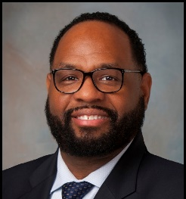
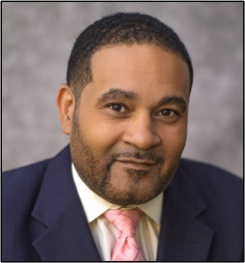
Chief Processing and Distribution Officer Organization
Chief Processing & Distribution Officer
VP Processing & Maintenance Operations
VP Regional Processing Operations, Eastern
VP Regional Processing Operations, Western
PLANNING
EXECUTION
Sr Dir Strategic Planning
Sr Dir Maintenance Operations HQ
Sr Dir Operational Excellence
Sr Dir Processing Operations
Sr Division Dir Processing Ops (x7)
Sr Division Dir Processing Ops (x6)

Slide 6



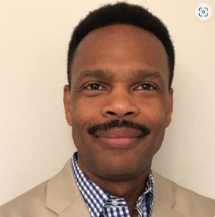


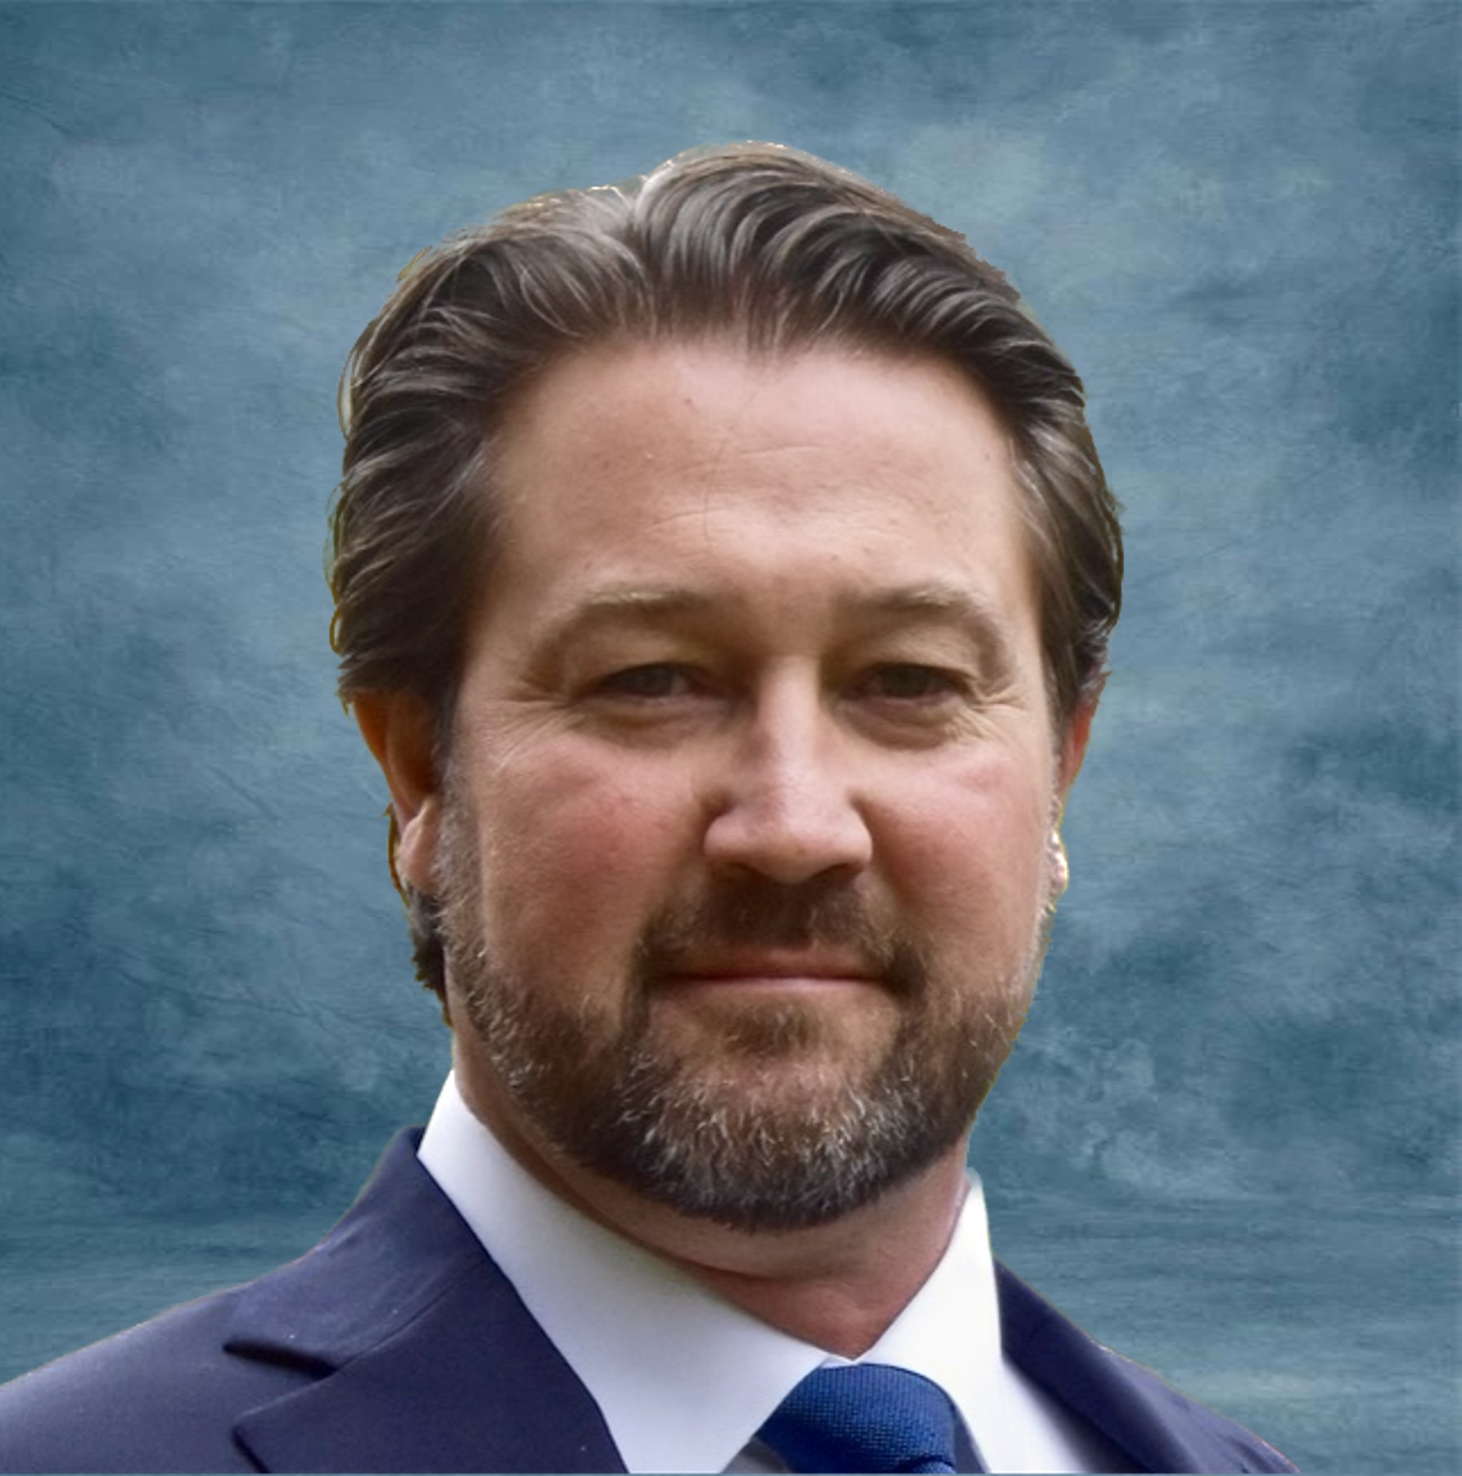
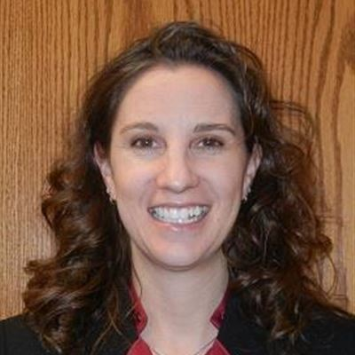

Chief Processing and Distribution Officer Organization
VP Processing & Maintenance Operations
Network Transformation and Redesign
Jim Herrmann
Dir, Network Transformation
Larry Wagener
Transition Implementation Director
Rick Pivovar
Transition Implementation Director
Mike Barber
Dir Operations Integration & Support
Dir International Processing Ops
Sr Dir Strategic Planning
Sr Dir Maintenance Operations HQ
Sr Dir Operational Excellence
Sr Dir Processing Operations
Fontell Peart
Robert Francis
Jason DeChambeau
Kevin Couch
Julie Weiser
Kristina Reynoso
Notes:
ISAAC
Introduces Mike –
“Running our planning and execution efforts from headquarters, we have Mike Barber”
CLICK TO SHOW PICTURES ON SLIDE
MIKE
Overview of mail processing/maintenance team
“Thank you, Isaac, this team is responsible for planning, implementation and daily processing and maintenance support for 354 facilities nationwide.”
“I also would like to point out our Network Modernization Team.”
CLICK TO SHOW NETWORK TRANSFORMATION AND REDESIGN TEAM PICTURES ON SLIDE
They oversee instrumental areas of our network transformation and redesign efforts across the nation.
I’d like to have my team stand up and be recognized.
[APPLAUSE]

Slide 7


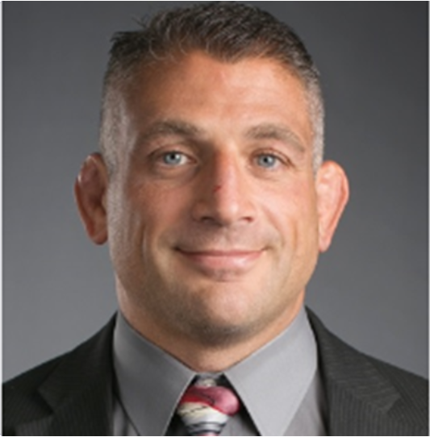

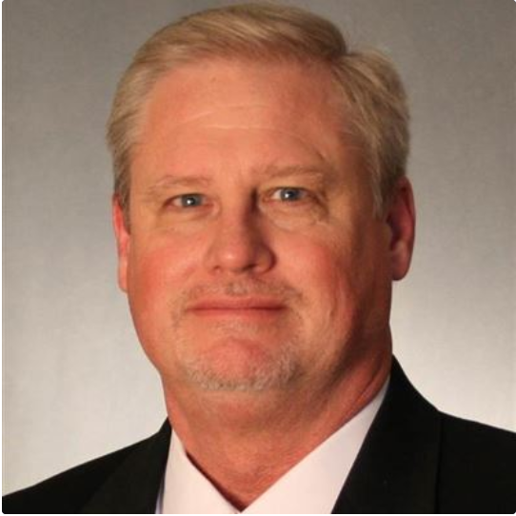
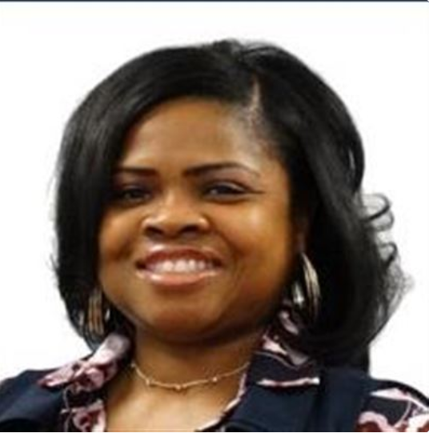
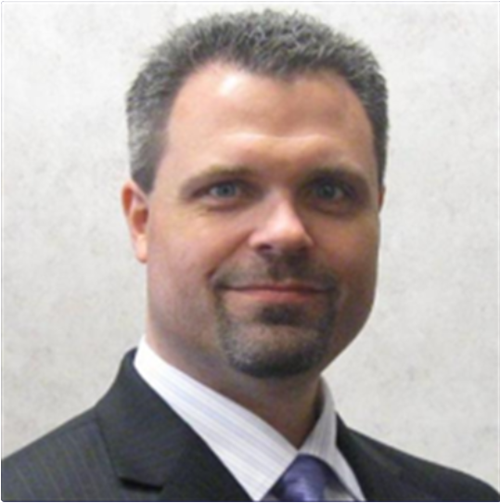

Chief Processing and Distribution Officer Organization
VP Regional Processing Operations, Eastern
Dane Coleman
Sr Division Dir Processing Ops
Sr Division Dir Processing Ops
Sr Division Dir Processing Ops
Sr Division Dir Processing Ops
Sr Division Dir Processing Ops
Sr Division Dir Processing Ops
Sr Division Dir Processing Ops
Christine Brisk
Stephen Humin
Dave
Webster
Scott
Tosch
Sharon
Young
Mark Dahlstrom
Steven Wojtaszek
Notes:
ISAAC
Introduces Dane –
“Thank you, Mike -- I would now like to introduce you to our team member responsible for managing our entire Eastern Region, Dane Coleman”
CLICK TO SHOW PICTURES ON SLIDE
DANE
Overview of Eastern Region processing team
I’d like to have my team stand up and be recognized.
[APPLAUSE]

Slide 8
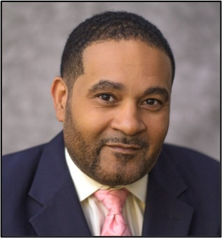




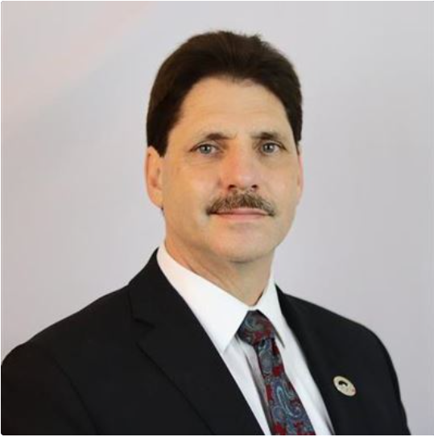

Chief Processing and Distribution Officer Organization
VP Regional Processing Operations, Western
Todd Hawkins
Sr Division Dir Processing Ops
Sr Division Dir Processing Ops
Sr Division Dir Processing Ops
Sr Division Dir Processing Ops
Sr Division Dir Processing Ops
Sr Division Dir Processing Ops
Frank
Veal
Garry
Tottress
Kathy
Hand
Felipe
Flores
John
DiPeri
Britton
Soto
Notes:
ISAAC
Introduces Todd –
“Thank you, Dane. And leading our Western Region, please give it up for Todd Hawkins”
CLICK TO SHOW PICTURES ON SLIDE
TODD
Overview of Western Region processing team
“All the way from Charleston, WV to California, and from Alaska to Hawaii”
I’d like to have my team stand up and be recognized.
[APPLAUSE]

Slide 9
Processing, Distribution & Maintenance Operations:
Vision Statement
Our vision is to provide precise, efficient, predictable processing and maintenance performance, that enables logistics and delivery operations to provide world class service to our customers and positions USPS for service excellence and financial sustainability
Build on our operational stability and precision by…
  Empowering, developing, retaining and engaging our people; ensuring employee safety and building a winning culture
  Driving performance, precision, effectiveness and efficiency by fully leveraging people, technology and analytics
  Simplifying and streamlining operations to enable the transformation and modernization of our processing network
Stabilize
Transform
Optimize

Slide 10

Processing, Distribution & Maintenance Operations:
Path to Service Excellence and Financial Sustainability
Recalibrate Operating Plan & Complement
Achieve Operating Precision
Modernize Processing Network
Build Engaged, Safe, Winning Culture
Simplify & Streamline Processing
Drive Performance Excellence
Stabilize
Optimize
Transform

Slide 11









Achieving Operating Plan Precision
Low Staffing High Overtime
Overtime Reduction
Operating Plan Precision
Achieve our processing plan at each facility every day; processing all expected volume by the expected clearance time
Precision in processing enables trucks to leave on time and mail to get to destination timely
Effective planning and daily execution; aligning staffing with workload, achieving throughput and clearance times by ensuring quality maintenance operations and standardized operator performance
Critically Late Trips
Trips Departing On Time
Lack of Operating Plan Precision
Achieving Operating Plan Precision
Late
Poor Quality
Product Clearance
Timely
High Quality Product Clearance
Poor Service
Service Improvement
Firefighting Culture
Winning Culture

Slide 12
CPDO – Summary of FY23 and Beyond Transformative Initiatives
People and Productivity
Improve retention with focus on career advancement and development
Implement cost reduction strategies
Continue to implement standard processing and maintenance operating procedures and equipment sets
Optimize staffing models to match workload by location
Develop clear and achievable operational goals
Service
Improve on processing precision to support end-to-end service improvements and clearance of volume
Collaborate with Logistics to identify and eliminate non-service responsive transportation routings
Continue to implement strategies to monitor “hot spot” locations and mitigate impacts expeditiously
Stabilize
Transform
Optimize
Focused Organization
Effective Planning and Execution
Enhanced Line-of-Sight
Improved performance and results
12

Slide 13
RPDC/LPC
Modernization
R

Slide 14
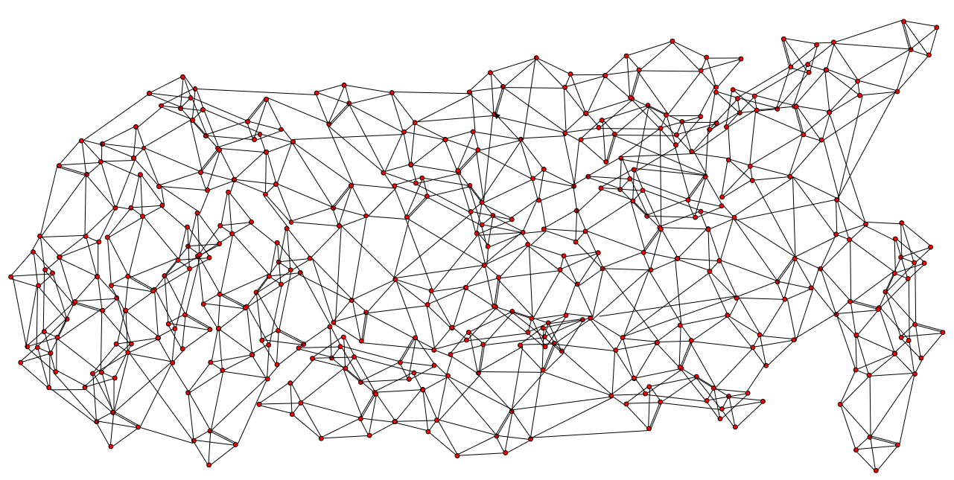
Current Processing & Distribution Networks
354 processing facilities
750,000 trips/week with average utilization less than 35%
Many-to-Many Transportation
6900+ machines, 34 different platforms
Small and outdated facilities
Not conducive for package processing

Slide 15
Current Processing & Distribution Networks
P&DC
B
P&DC
STC 1
P&DC
A
D
P&DC
C
STC 2
P&DC
A
B
E
STC 1
A
G
P&DC
F
STC 1
STC 2
G
P&DC
C
D

Slide 16
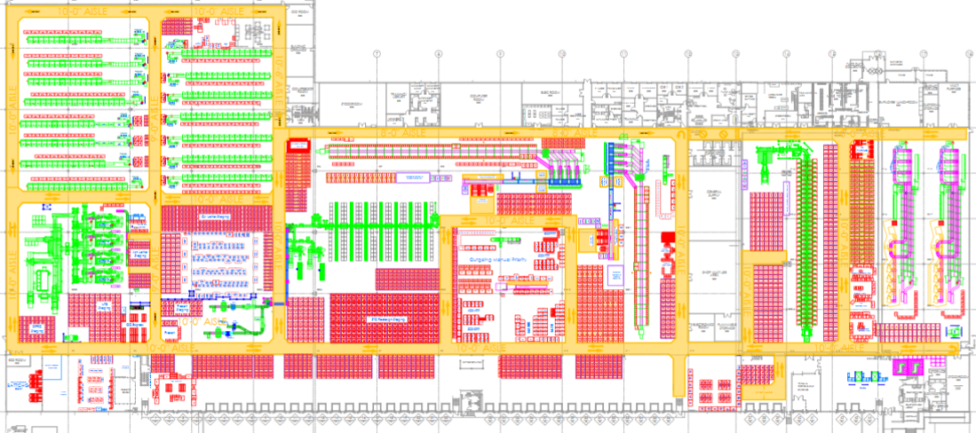

Current Processing & Distribution Networks
Cluttered Areas
Machine location not conducive to efficient mail flow
P&DC
ANNEX
Several small package sorters
Insufficient Docks
NDC
PSA
Multiple Processing Facilities in the same vicinity

Slide 17
Future Processing & Distribution Network
~240 processing facilities
Fewer trips per week with higher utilization
Point to point transportation
Standardized machines and platforms
New and repurposed facilities
Integrated and efficient mail and package processing
Notes:
DANE
Future Facility Network –
by the numbers
230 processing facilities
Fewer trips per week with higher utilization (point to point transportation)
Standardized machines and platforms
New and repurposed facilities
“These new facilities will truly encompass our package processing network”

Slide 18
Regional Processing Distribution Center (RPDC)
DU
DU
RPDC
/LPC
Collection
Delivery
DU
SDC
LPC
RPDC
CRRT Packages
DU
OG/INC Packages
OG Letters
OG Flats
DU
DU
DU
DU
RPDC
SDC
INC/DPS Letters
INC/CRRT Flats
DU
LPC
DU
DU
DU
SDC
DU

Slide 19
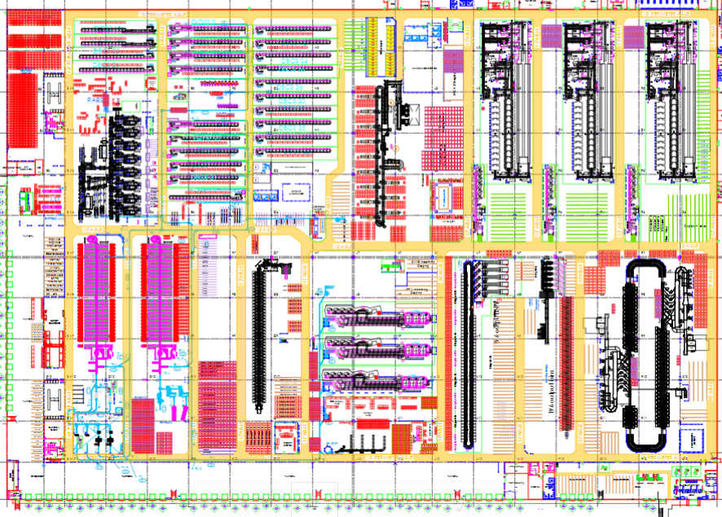
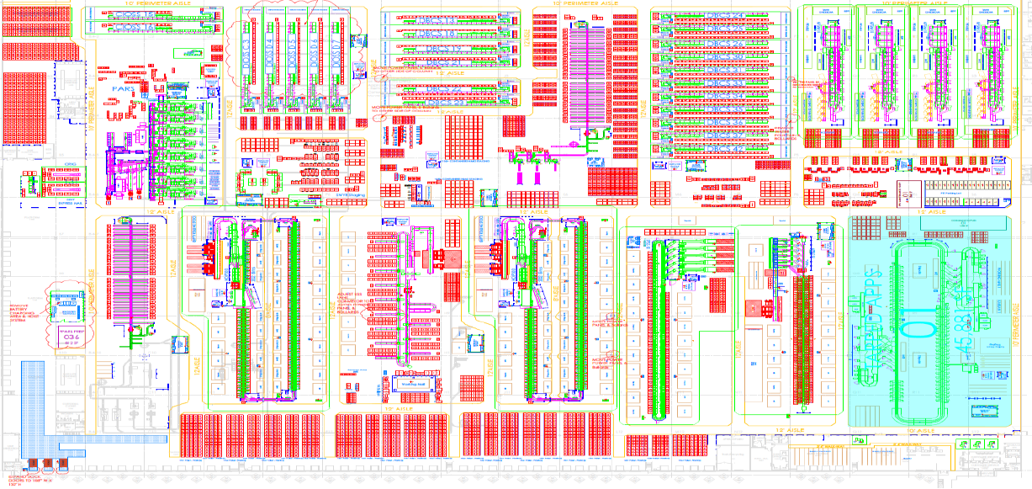
Regional Processing Distribution Center (RPDC)
Letters
Letters
Tray Sorter
Letters
Flats
Flats
Packages
Tray Sorter
Tray Sorter
Flats
Packages
Packages
Packages
Dispatch
Dispatch
Dispatch

Slide 20
Richmond VA RPDC
This region covers a portion of Richmond and Norfolk, Virginia Metro Areas handling the following 3-digit ZIP codes:
  233, 234, 235, 236, 237, 279, 224, 225, 229, 230, 231, 232, 238, 239, 244
The Regional Processing and Distribution Center in Richmond is slated for a minor rehabilitation and workroom reorganization
Two Local Processing Centers are associated in the region.
The RPDC Region is centered in Sandston, VA.US-R-0001

Slide 21
Peak Season Summary

Slide 22






FY23 Processing Peak Highlights
50
+13.1% pts
+2.5% pts
Additional Package Sorters
Improved Precision
Improved Efficiency
-21%
75%
-2% pts
Processing Delay Reduction
Fewer Peak Hires
Overtime Usage

Slide 23
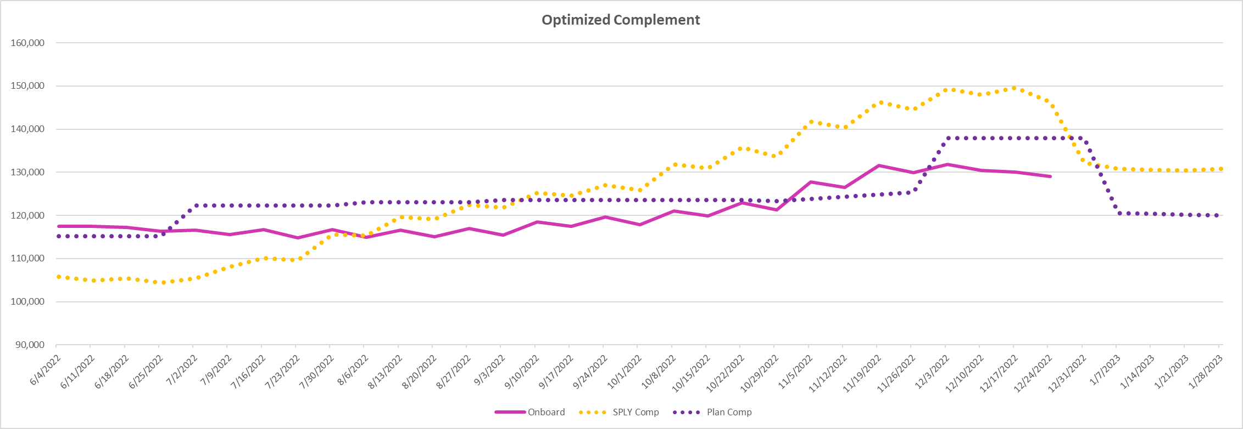
Processing Peak Staffing
Reduced reliance on peak season staffing
Employed 6K PSE clerks
Employed 7K MHA mail handlers
Reduced peak staffing enables increased efficiencies and reduced cost
Notes:
Can we compare sq. ft. to last year

Slide 24
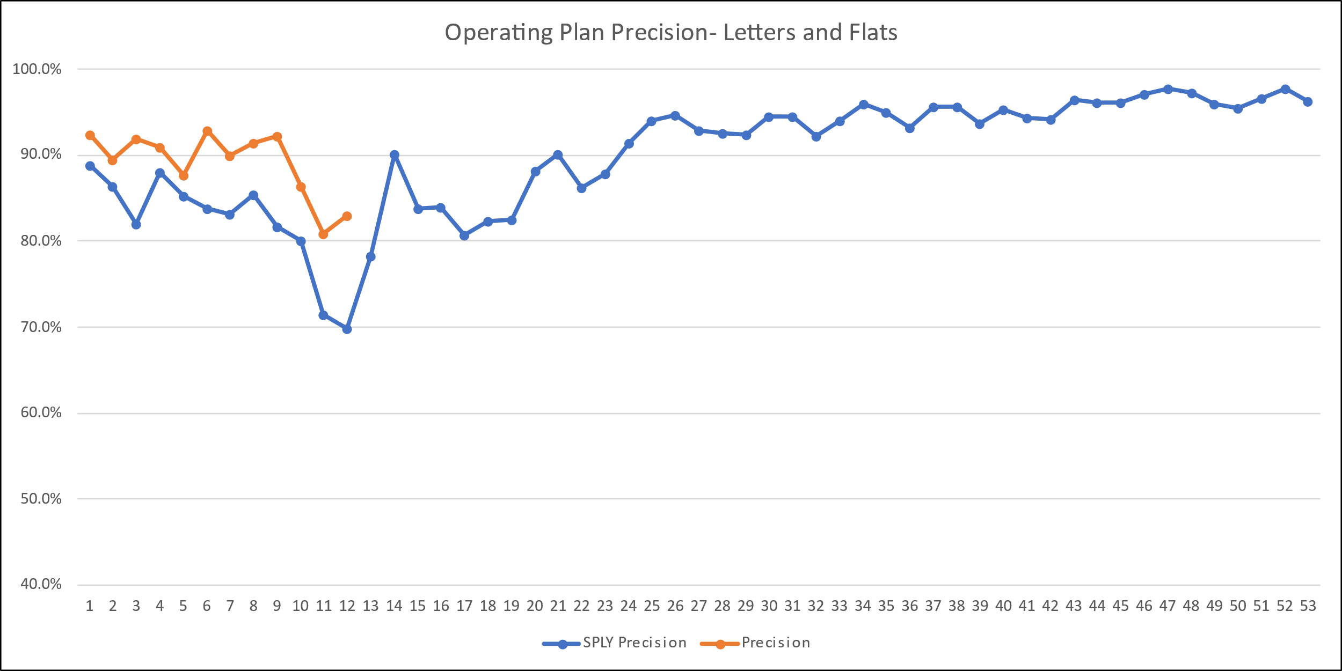
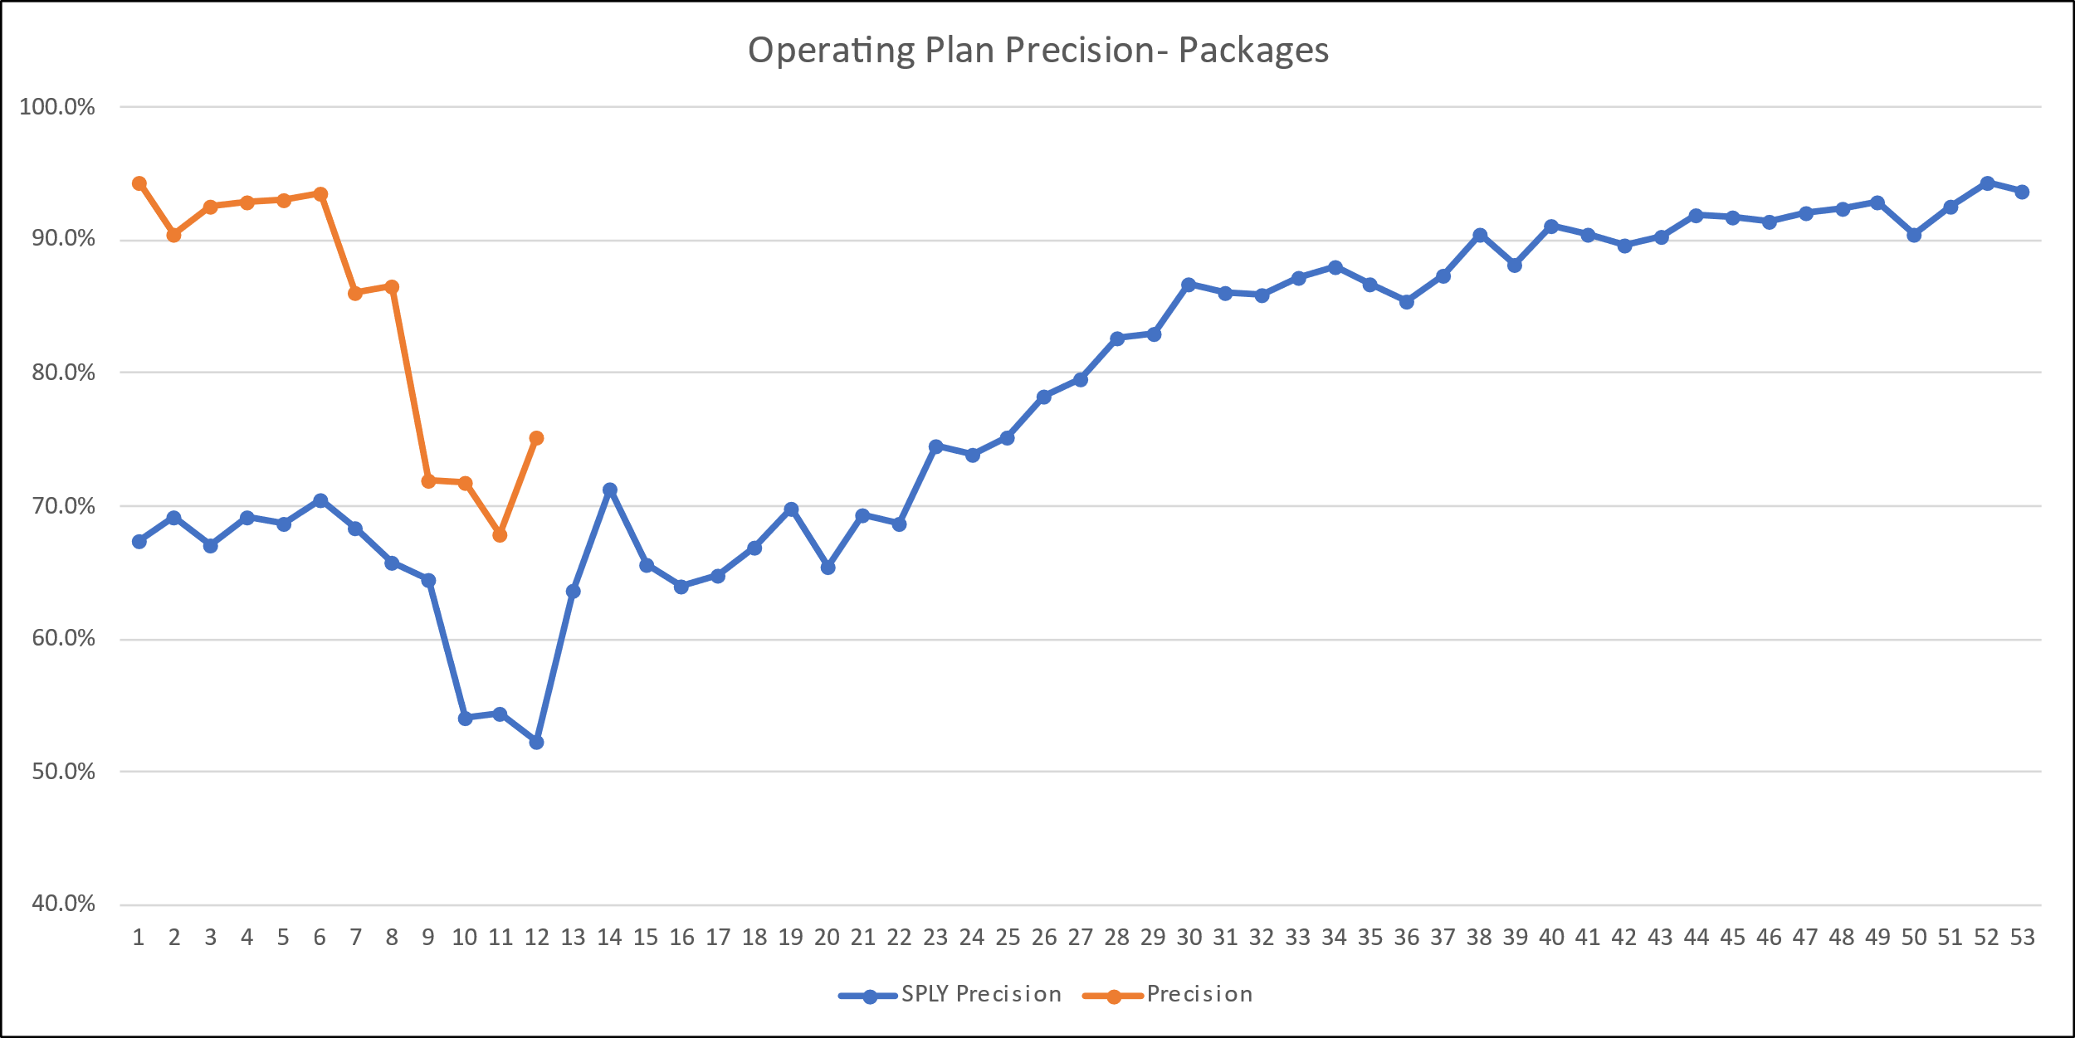
Processing Precision
Significantly improved precision compared to last year and well positioned for Peak
Achieve our processing plan at each facility every day; processing all expected volume by the expected clearance time
Precision enables trucks to leave on time and mail to get to destination timely
Peak Period Precision up 13.1% to last Peak
Notes:
Can we compare sq. ft. to last year

Slide 25
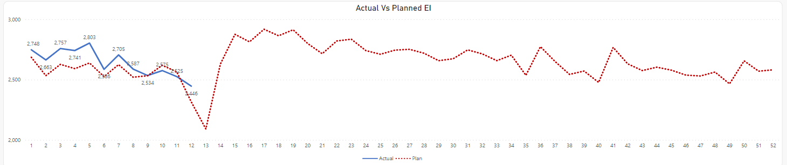
Operational Efficiency
Driving productivity by Division and Plant
Matching workhours to workload
Improved Efficiency to last peak +2.5%
Source: WebEOR
25

Slide 26
Peak Season Processing
Strategies | Results
Year-round employee complement strategy Continued service improvement since last peak Optimize use of additional operational space Leverage additional package processing capacity Focus on efficiency and precision | Reduced reliance on temporary peak season employees by 75% Improved employee availability > 80% Reduced workhours by 9.5% Reduced overtime by 2% points Plants remained fluid throughout Reduced processing delays: 21% reduction for all products and 46% reduction for packages Significant improvement for processing precision Improved service Improved days to delivery Reduced tail - next day recovery on service failures

Slide 27
Thank You

