Slide 1
Fleet Management Overview

Slide 2
Snapshot of the Postal Vehicle Fleet & Support
By The Numbers
Supporting the Fleet
How we Support
246,050 Vehicles
306 Vehicle
Maintenance Facilities
Fleet Strategy & Support
Policy Creation & Evaluation
Vehicle Acquisition Strategy
VMF Support
Project Management
Supplier/Vendor Liaison
224,985 Delivery
5,000 Technicians,
Clerks, Managers
7,669 Logistics
13,396 Support
$330M Contract Labor
7,000 Contract Garages
Fleet Operations
19,000 Delivery Units
145 PVS Locations
$384M in Parts Spend
4M Parts in Stock
3 Consignment Suppliers
Vehicle Maintenance & Repair
Manage Maintenance Costs
Responsible for Vehicles Life Cycle
Safety & Environmental Compliance
Vehicle counts as of 9/25/23
Excludes inactive and unmaintainable vehicles

Slide 3
Facilities and Fleet Management
New VP organization announced March 28 – Fleet Management & Electrification Strategy
Fleet Management
NGDV Project Management Office
Facilities
Aligns all vehicle related activities under one Sr. Vice President who reports directly to the PMG

Slide 4
Fleet Management & Electrification Strategy
Sr VP, Facilities and Fleet Management
VP, Facilities
Director, Fleet Management
Director, NGDV Programs
Executive Manager, Fleet Strategy and Support
Executive Manager, Fleet Operations
Fleet Operations Specialists
Sr. Fleet Operations Specialists
Manager, Fleet Operations (Region)
Fleet Operations Specialists
Manager, Vehicle Operations
VMF Groups

Slide 5
Vehicle Acquisition & Deployment

Slide 6
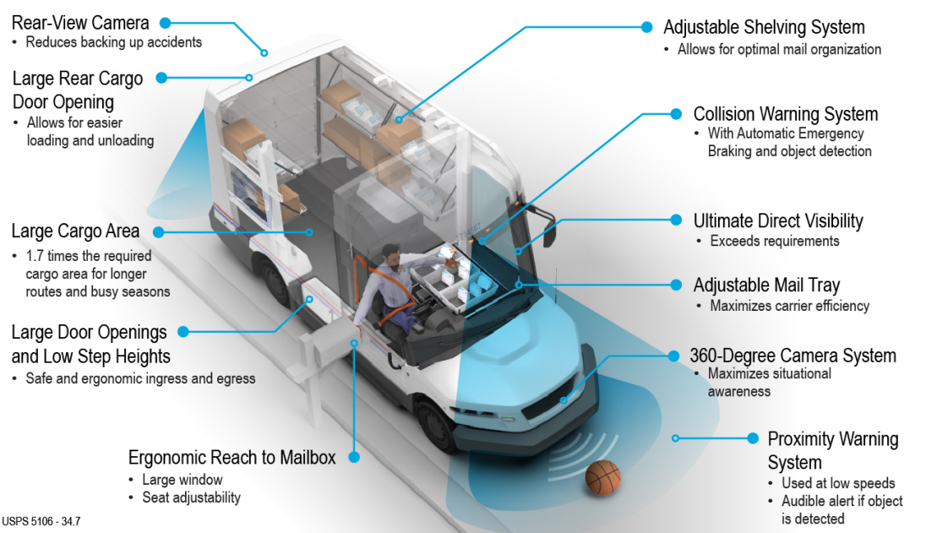
The Need for a Purpose Built RHD Delivery Vehicle
RHD requirement
Limited COTS
availability
Unique ergonomics for curb-line delivery
Durability to enable 20 years of service

Slide 7
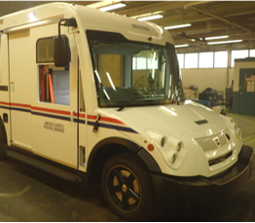
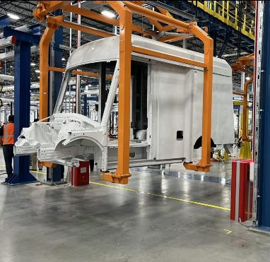
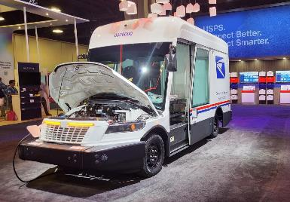
The Journey to the New USPS Purpose Built Vehicle
July 2014 – July 2015
Sep 2016 – Dec 2019
Jan 2020 - Feb 2021
Jan 2020- Feb 2021
Feb 2021 – On going
Acquisition Planning
NGDV Requirements Analysis
Emerging Technology Research
Fleet renewal and replacement analysis
Prototype RFI / RFP Development
Protype Planning
Supplier Conference
Supplier Selection
Prototype Proposal Evaluation and Contract Award
Prototype Development & Evaluation
Prototype Design, Build & Testing
Mixed Fleet Strategy and Total Cost of Ownership Analysis
Proposal Evaluation
Proposal Evaluation
Contract Award
Production Planning & Acquisition
Production Vehicle Design and Build
Deployment Planning
Production Testing
Training
Deployment

Slide 8
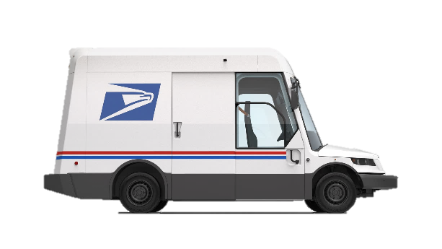
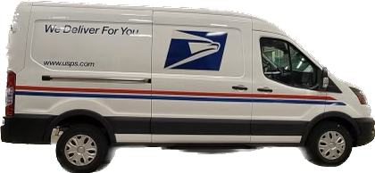
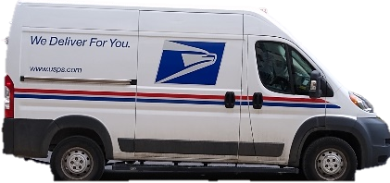
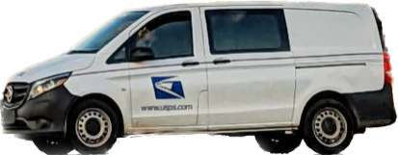
Vehicle Acquisition Plan Through 2028
NGDV (RHD) | Ford E-Transit (LHD) | Ram ProMaster (LHD) | Mercedes Metris (RHD) | TDB (RHD)
BEV: 45,000 ICE AWD: 5,000 ICE 2WD: 10,000 | BEV: 9,250 | ICE: 9,250 | ICE: 14,500 | TBD
Deployment Start: June 2024 | Deployment Start: Dec 2024 | Deployment Start: Oct 2024 | Deployment Start: Ongoing | TBD
Replace LLV/FFVs on routes with >=21 curbside stops | Replace LLV/FFs on routes with <21curbside stops | Replace LLV/FFs on routes with <21curbside stops | Replace LLV/FFVs on routes with >=21 curbside stops | Replace LLV/FFVs on routes with >=21 curbside stops and height restricted routes

Slide 9
Deployment at Network Modernization Facilities
BEV acquisitions are enabled by, and align with, network modernization initiative
Deployment of BEVs will complement roll-out of Sorting and Delivery Centers (S&DCs) nationwide
Accompanying the modernization of delivery operations with modernization of the delivery fleet
S&DCs are more likely to support the power and infrastructure needs required by an electric fleet
less infrastructure upgrades required to deploy
Allows for economies of scale in infrastructure and deployment logistics vs. deploying to myriad small locations

Slide 10
Modernization Initiatives Update

Slide 11
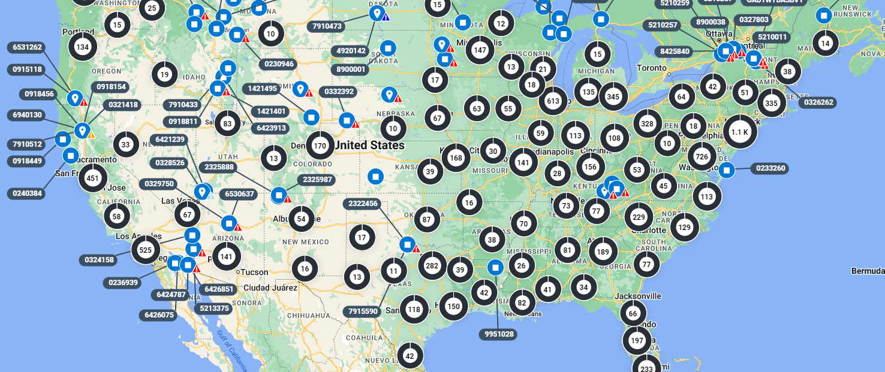
Connecting the Fleet through Integrated Fleet Management
Enabling Savings & Operational Improvements Through Vehicle Telematics & A Modern Fleet Management Information System (FMIS)
Key Objectives:
Equip all USPS-owned vehicles with telematics devices
245,000+ delivery, logistics, and Support vehicles
Deploy a modern, COTS Fleet Management Information System
Integrate telematics, vehicle maintenance data, and existing USPS systems to streamline Fleet operations
Program Benefits:
Reduce Fleet Maintenance Costs
PMI scheduling based on actual vehicle usage
Automatic workorder creation from telematics data
Improve Fuel Efficiency
Improve MPG through repairs based on telematics
In-vehicle alerts for harsh driving & speeding
Improve Vehicle Utilization Visibility
Optimize vehicle placement & fleet size
Distribute usage more evenly with vehicle rotation
Enable Improved Processes
Track parts quality & streamline usage
Simplified vehicle acceptance process
Current Progress:
Over 104,000 vehicles equipped with telematics
FMIS development on track for early FY24 rollout start
Key process improvements mapped

