Slide 1
Introduction to the Postal Service Health Benefits (PSHB):
What You Need to Know
Southern Area
September 2023

Slide 2
Postal Service Health Benefit (PSHB) Plan

Slide 3
PSHB Overview
The Postal Service Reform Act of 2022 mandated the implementation of the Postal Service Health Benefits (PSHB) program. The PSHB is a new plan administered by the Office of Personnel Management (OPM), which will provide health insurance to Postal Service employees, Postal Service annuitants, and their eligible family members starting in 2025. The PSHB plan is within the Federal Employees Health Benefit (FEHB) Program.
Key PSHB Highlights:
All participants will transition to the PSHB plan.
PSHB plan carriers will be identified in FY24.
Voluntary Medicare integration opportunity for existing retires will occur FY24.
PSHB plan enrollment will transition from PostalEASE to a central enrollment platform (CEP) administered by OPM.

Slide 4
PSHB Facts
Below is a list of facts regarding the PSHB Program for active employees:
You are required to select a health insurance plan in the PSHB Program during the 2024 open season period, from November 11, 2024 – December 9, 2024.
If you are an active employee age 64 or older as of January 1, 2025, you ARE NOT required to enroll in Medicare Part B to continue your PSHB health insurance coverage once you retire. However, upon your retirement and entitlement to Medicare Part A (typically at age 65), you will have the option to enroll in Medicare Part B during a special enrollment period.
If you are the primary subscriber, your covered family members will not be required to enroll in Medicare Part B to stay on your PSHB plan; however, enrollment in Medicare Part B may reduce your overall costs for health care-related expenses and may provide better value for you and your family.

Slide 5
PSHB Facts
If you are an active employee under the age of 64 as of January 1, 2025, to continue your PSHB health insurance coverage in retirement, you WILL BE required to enroll in Medicare Part B after you retire and become entitled to Medicare Part A (typically at age 65).
If you are the primary PSHB enrollee, your covered family members will also be required to enroll in Medicare Part B when you retire, upon their entitlement to Medicare Part A, if they wish to remain covered by your PSHB insurance.
If you retire on or after January 1, 2025, and you are under 64, you WILL BE required to enroll in Medicare Part B when you become entitled to Medicare Part A (typically at age 65) to remain enrolled in a PSHB plan. The Social Security Administration (SSA) will mail you a notice when you are eligible to enroll in Medicare Part B during your initial enrollment period. Your initial enrollment period starts three months prior to your 65th birthday and ends three months after your 65th birthday. If you are the primary PSHB subscriber, your covered family members will also be required to enroll in Medicare Part B upon their entitlement to Medicare Part A, if they wish to remain covered by your PSHB insurance.

Slide 6
PSHB Facts
There are exceptions to the requirement to enroll in Medicare Part B as an annuitant. These exceptions will also apply to your covered family members. Annuitants may be responsible for providing proof of eligibility for the applicable exception(s) to the designated agency. These exceptions are:
You are residing outside of the United States and its territories. You are required to follow the policy and procedure set forth by the Postal Service to be eligible for this exception; or
You are enrolled in health care benefits provided by the Department of Veterans Affairs; or
You are eligible for health services provided by Indian Health Services.
As a general rule, spousal and family member PSHB coverage is based on the primary enrollee’s eligibility. If the primary subscriber is required to enroll in Medicare Part B, dependent family members will also be required to enroll when they are eligible.

Slide 7
PSHB Annuitant Facts
If you are an annuitant as of January 1, 2025, and not currently participating in Medicare Part B, you ARE NOT required to enroll in Medicare Part B to continue your health insurance coverage in the new PSHB Program. Participation in Medicare Part B is voluntary; however, enrollment in Medicare Part B may reduce your overall costs for health care-related expenses and may provide greater value.
Your covered spouse and eligible family members will also not be required to enroll in Medicare Part B even if they are age 65 or older; however, enrollment in Medicare Part B may reduce overall costs for health care-related expenses and may provide greater value.
Note: If you are an annuitant as of January 1, 2025, and are already enrolled in Medicare Part B, you ARE required to remain enrolled in Medicare Part B to continue coverage under PSHB.
If you are an annuitant entitled to Medicare Part A (typically at age 65) prior to January 1, 2024, and have not enrolled in Medicare Part B, you and your covered, eligible family members may be able to participate in the special enrollment period (SEP) for Medicare Part B that starts on April 1, 2024. Those who enroll during the SEP will not need to pay the late enrollment penalty. Eligibility letters will be sent to annuitants and eligible family members in early 2024.
As a general rule, spousal and family member PSHB coverage is based on the primary subscriber’s eligibility. If the primary subscriber is not required to join Medicare Part B, neither will dependent family members. Likewise, if you qualify for the SEP, so will your covered family members.

Slide 8
Additional Information on PSHB
The PSHB program is part of the FEHB program
PSHB plan carriers will be comprised of current FEHB plan carriers
Cost sharing for the PSHB plan premiums will be the same as FEHB premiums
The 5-year rule regarding continuous coverage encompasses participation in FEHB and PSHB plans
Implementation of the PSHB program does not impact your retirement benefits
If you are Postal employee who transfers to another Federal agency, you will transition back to FEHB plan participation
PSHB plan information will not be available until 2024

Slide 9
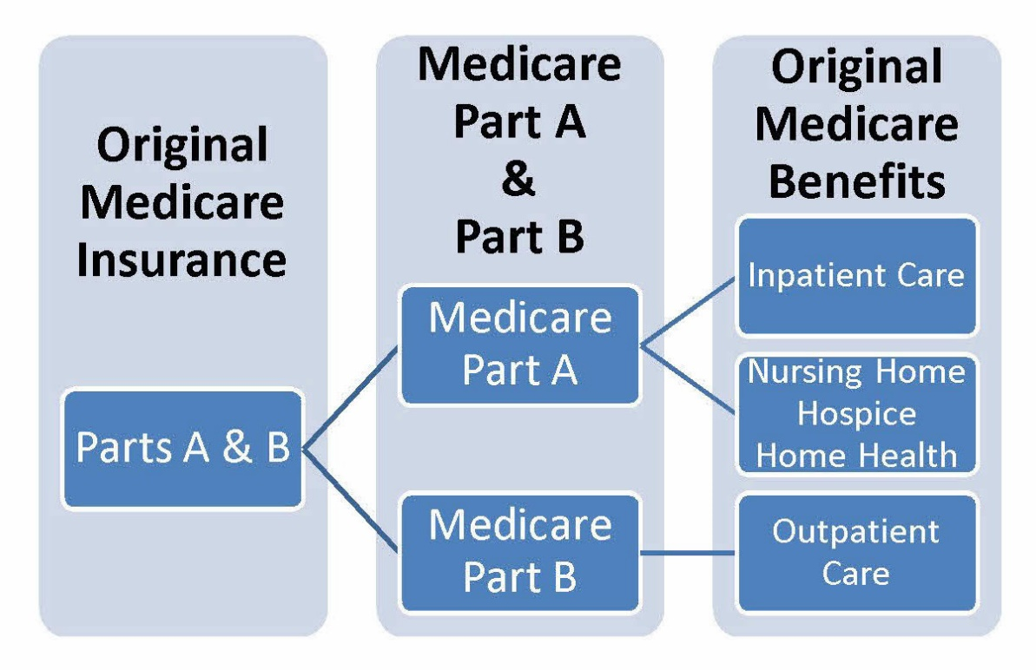
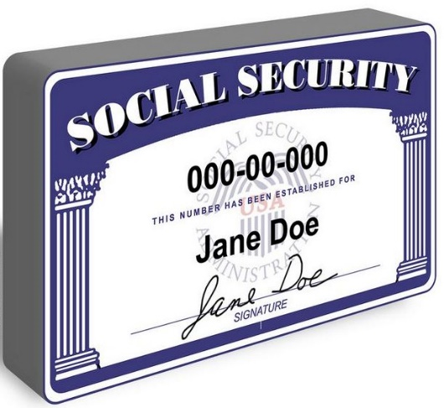
Social Security & Medicare

Slide 10
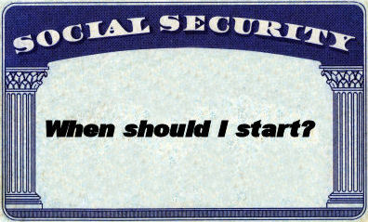
Social Security
When can I start collecting my Social Security benefits?
Deciding when to start collecting Social Security is one of the most important decisions you'll make. If you are currently facing this decision, there are several things to consider.
Social Security benefits are based on your lifetime earnings and are calculated on the amount you would receive at your full retirement age.
The actual amount you receive each month depends on when you start receiving benefits.
The earliest you can start receiving your Social Security retirement benefits is age 62.

Slide 11
Social Security
You will receive 100% of your benefits if you wait until your full retirement age.

Slide 12
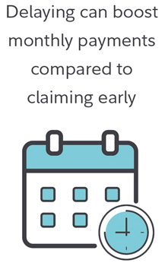
Social Security
Notes:
You can wait until your full retirement age or some people will collect Social Security at age 62 but their full retirement age is 66.
At 62 it will be $750 and it will only gradually increase due to cost of living.
Had you wait until age 70, your benefit would have started at $1,320.
Its all depends on what your financial situation and when you want to collect Social Security.
For FERS EE’s: Please keep in mind whatever you decide your FERS Supplement will STOP at age 62.

Slide 13
Medicare

Slide 14
Understanding Medicare
If you are eligible for Medicare, you may have choices in how you get your health care.
Medicare is a health insurance program for:
People 65 years of age and older
Some people under age 65 with disabilities
People with end-stage renal disease

Slide 15
Understanding Medicare
Part A
Covers inpatient hospital, skilled nursing facility care and home health care.
Part B
Covers most doctors' bills, as well as some medical services and supplies.
No cost for most
Monthly premium
By signing up for Medicare Part B, retirees may be able to select a lower cost FEHB plan, as well as benefit from lower out-of-pocket costs.

Slide 16
Understanding Medicare
Part C
Medicare Advantage Plans offered by private companies provide all Part A and Part B benefits. Most include Part D.
Part D
Prescription drug coverage.
Monthly premium.
Normally not necessary if enrolled in FEHB.
Monthly premium.
Normally not necessary if enrolled in FEHB.
You may save money by enrolling in a Medicare Advantage Plan (Part C) and suspending your FEHB coverage

Slide 17
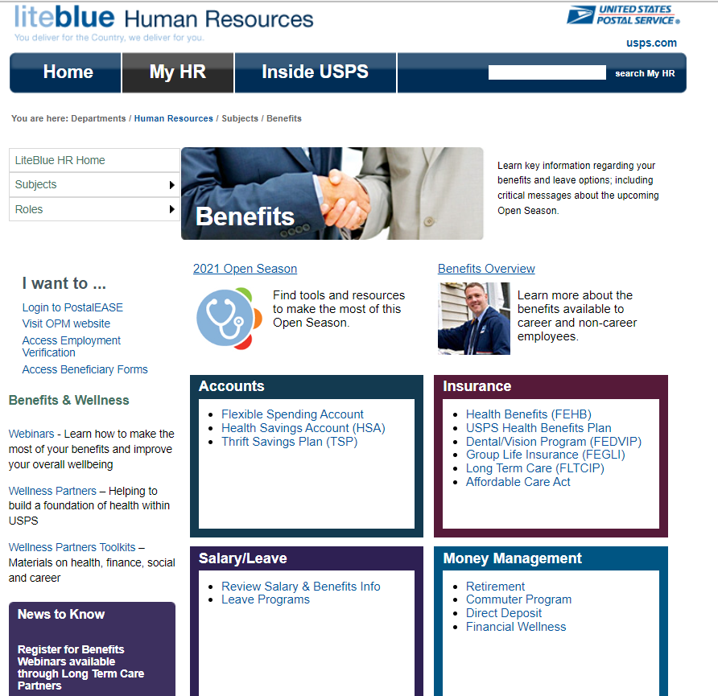
Benefits Information
https://liteblue.usps.gov/benefits/

Slide 18
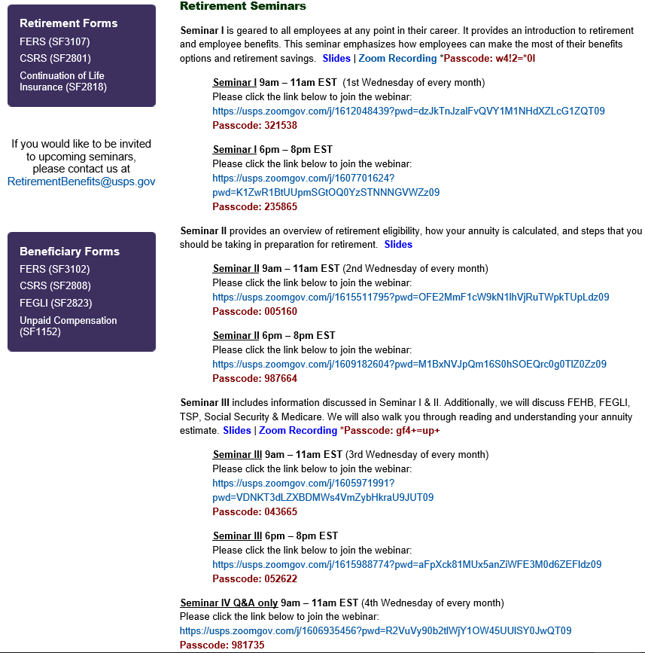
Planning for Retirement
Check out liteblue.usps.gov/retire to visit our page!

Slide 19
Let’s Stay Connected
Sign Up for SMS Text Messaging!
Text messages will include important information related to benefits, wellness, financial education, and more.
Text 39369 of the updates you would like to receive:
PSHBP – For updates on the PSHB program
BENEFITS – For updates on benefits information
RETIREE - For annuitant related information
Email questions to: retirementbenefits@usps.gov

